Slide 1


UNIVERSITY INSTITUTE OF ENGINEERING
COMPUTER SCIENCE ENGINEERING
Bachelor of Engineering (Computer Science & Engineering)
Subject Name: STATISTICAL METHODS USING R
Subject Code: 20SMT-460

Slide 2
Bayes’ Theorem

Slide 3
Introduction to Bayes’ Theorem
Bayes' theorem relates to the concept of probability in mathematics. It is one of the formulas that have their practical application in almost all the areas that derive their results from predictions and probability. One can think of weather predictions where the meteorologists use the Bayes' Theorem to predict the day-to-day weather forecast. The scientist can even forewarn the people about prevailing possibilities of bad weather so they can make the required arrangements. Similarly, there are many other fields where Bayes' Theorem is applied. Let’s see more details about Bayes’ theorem.

Slide 4
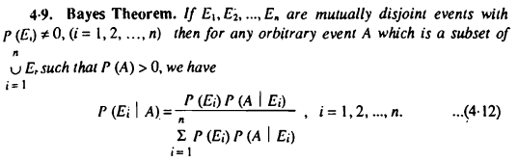

Slide 5
Example 1: A bag I contains 4 white and 6 black balls while another Bag II contains 4 white and 3 black balls. One ball is drawn at random from one of the bags, and it is found to be black. Find the probability that it was drawn from Bag I.
Solution:
Let E₁ be the event of choosing bag I, E₂ the event of choosing bag II, and A be the event of drawing a black ball.
Then,

Slide 6
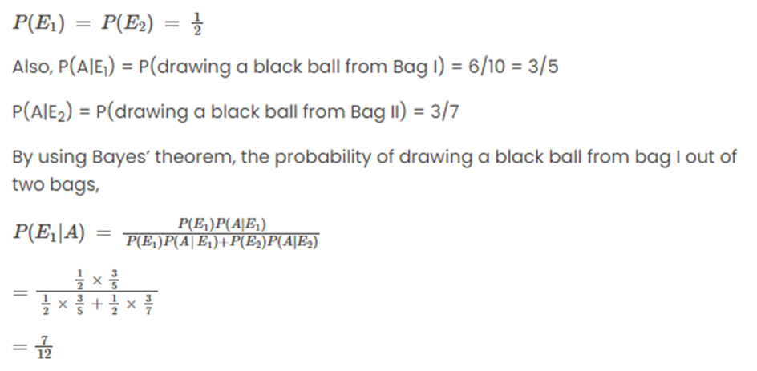

Slide 7
Example 2: A man is known to speak the truth 2 out of 3 times. He throws a die and reports that the number obtained is a four. Find the probability that the number obtained is actually a four.
Solution:
Let A be the event that the man reports that number four is obtained.
Let E₁ be the event that four is obtained and E₂ be its complementary event.
Then, P(E₁) = Probability that four occurs = 1/6.
P(E₂) = Probability that four does not occur = 1- P(E₁) = 1 – (1/6) = 5/6.
Also, P(A|E₁)= Probability that man reports four and it is actually a four = 2/3
P(A|E₂) = Probability that man reports four and it is not a four = 1/3.

Slide 8
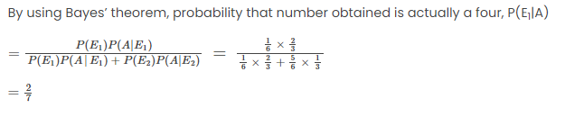

Slide 9
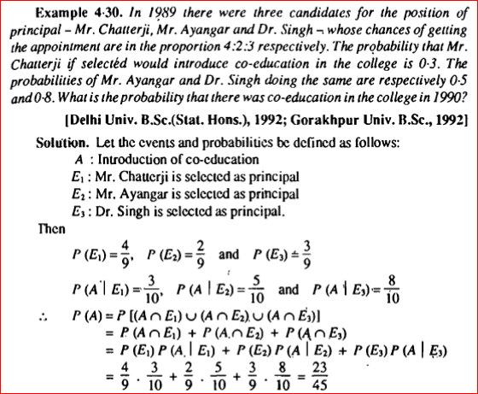

Slide 10
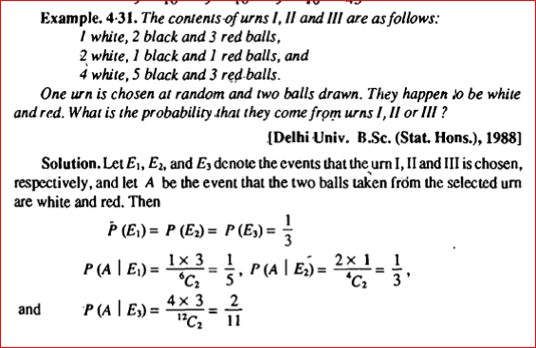

Slide 11
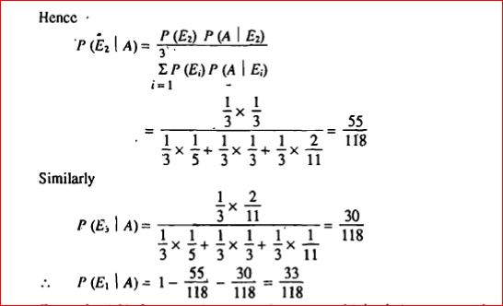

Slide 12
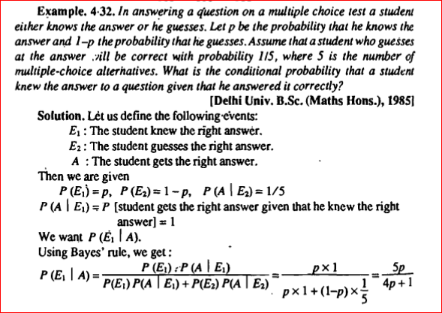

Slide 13
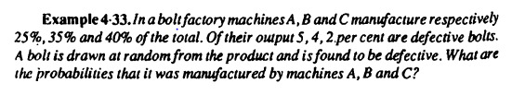

Slide 14
